Slide 1
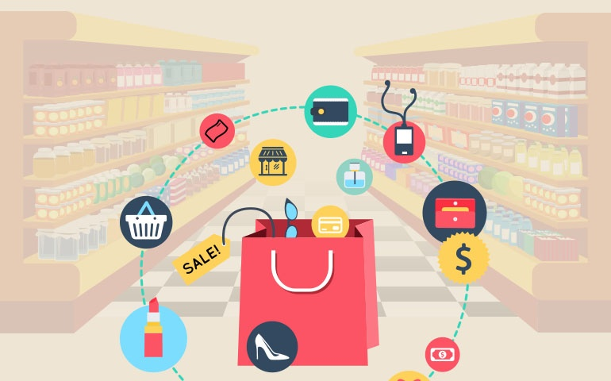
ASSOCIATION RULE MINING Market Basket Analysis

Slide 2
CONTENTS
Introduction
Objectives
Procedure
Applications

Slide 3
INTRODUCTION
A large number of people visit shopping malls and grocery stores
There, massive amounts of data is continuously being stored in the form of transactions
This data can be helpful from the business perspective especially in forming new marketing strategies

Slide 4
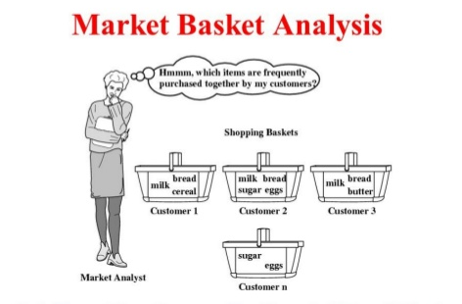
OBJECTIVE
To find frequently purchased item sets from large transactional database

Slide 5
DEFINITION
Discovering frequent items sets from transactional data
Frequent item set mining leads to the discovery of associations and correlations among items
Typically, association rules are considered interesting if they satisfy both; a minimum support and a minimum confidence threshold

Slide 6
Approach
We have used the Apriori Algorithm to find the frequent item sets.

Slide 7
APPLICATIONS
Cross Selling
Product Placement
Customer Behavior
Affinity Promotion
Maintain Inventory
Notes:
Cross selling: A sales technique in which seller suggests some related product to a customer after he buys a product.
Product Placement: It refers to placing the complimentary (pen and paper)and substitute goods (tea and coffee) together so that the customer addresses the goods and will buy both the goods together.
Customer Behavior: It allows the retailer to identify the relationship between two products that people tend to buy.
Affinity Promotion: A method of promotion that design promotional events(deals) based on associated products
Maintain Inventory: Know what are the products that your customers are going to buy in future and you can maintain your inventory accordingly.

Slide 8
THANK YOU!

